Slide 1
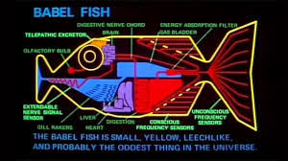
Babel Chat
Socket Programming Application

Slide 2
Features
One Server - Multiple Clients
Multimedia Transfer
Supports multiple languages

Slide 3
Software Overview
Server is set up on the virtual machine on a local network
AWS is used for translating the chats (boto3 and aws client interface)
Tkinter python package is used for handling the GUI interface
All communications between clients are handled via TCP

Slide 4
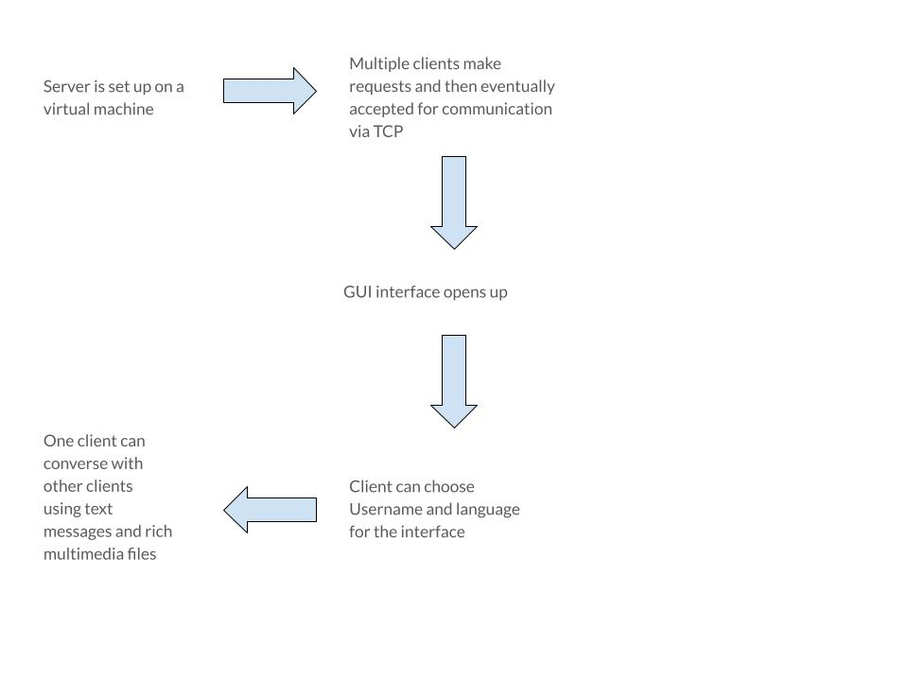
Workflow

Slide 5
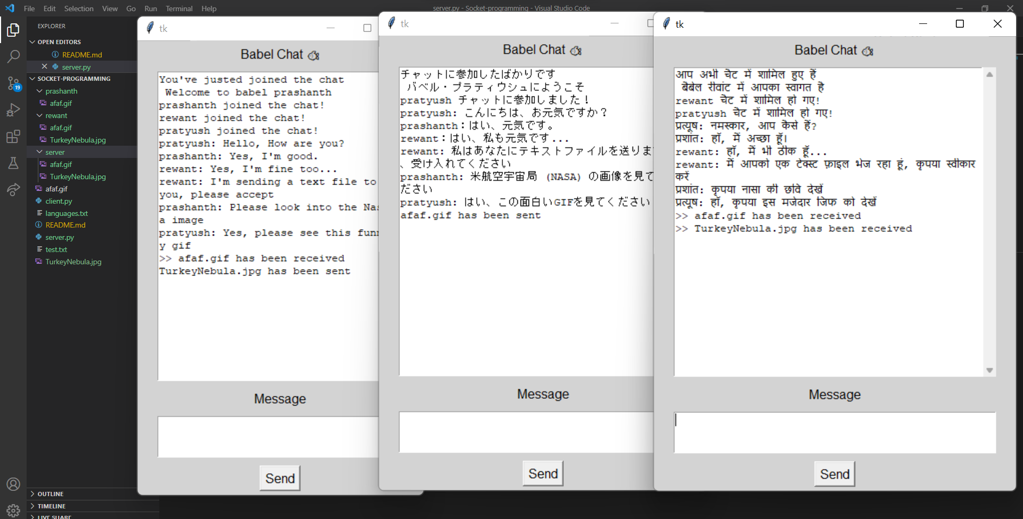
Results

Slide 6
References
The information used in our application has been taken from the following resources:
AWS:
Amazon AWS
Socket Programming:
Socket Programming in Python (Guide) – Real Python
Translation:
https://stackabuse.com/text-translation-with-google-translate-api-in-python/
https://docs.aws.amazon.com/translate/latest/dg/examples-python.html

